Slide 1

Smart Camera using MQTT
Presented By:
Pranay Ponnappa S K (01617439)
Anthony Ittiyera V (01596046)
Pavan Kumar B L (01574465)
Naveen Ravi (01598885)

Slide 2
Requirements
Hardware:
Raspberry Pi model B+
PIR Motion Sensors
Camera
Software:
Raspbian Jessie Pixel
Mosquitto MQTT Client / Server / Broker
Paho MQTT

Slide 3
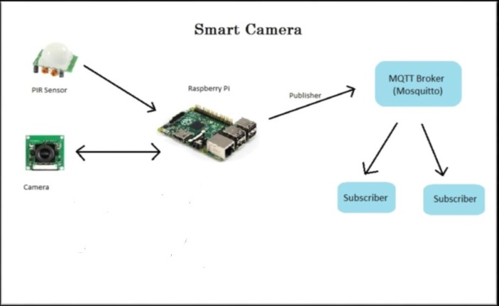
SYSTEM DESIGN

Slide 4
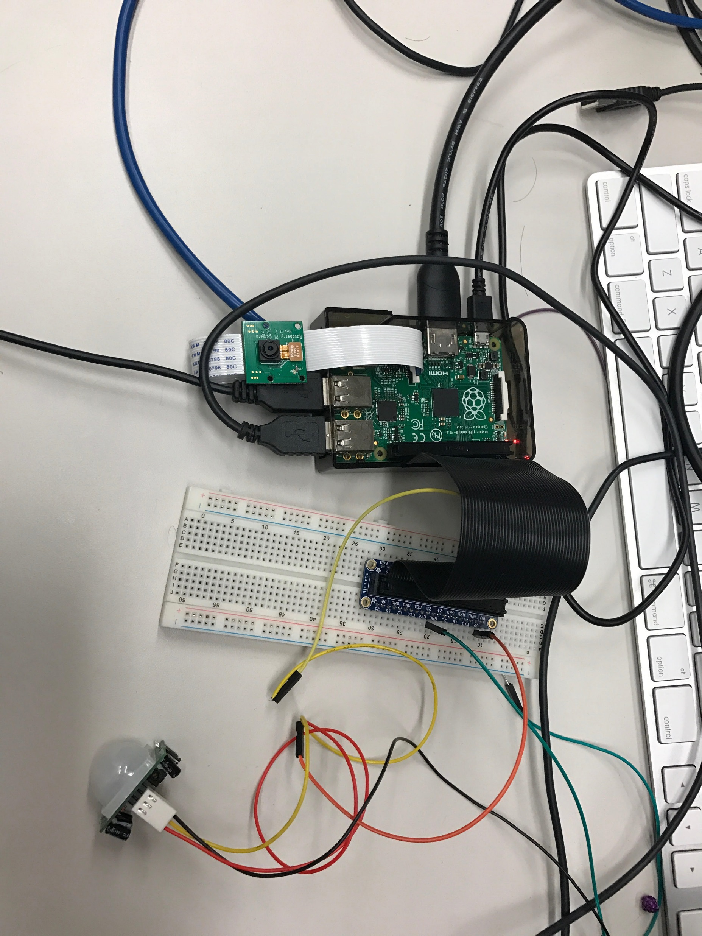
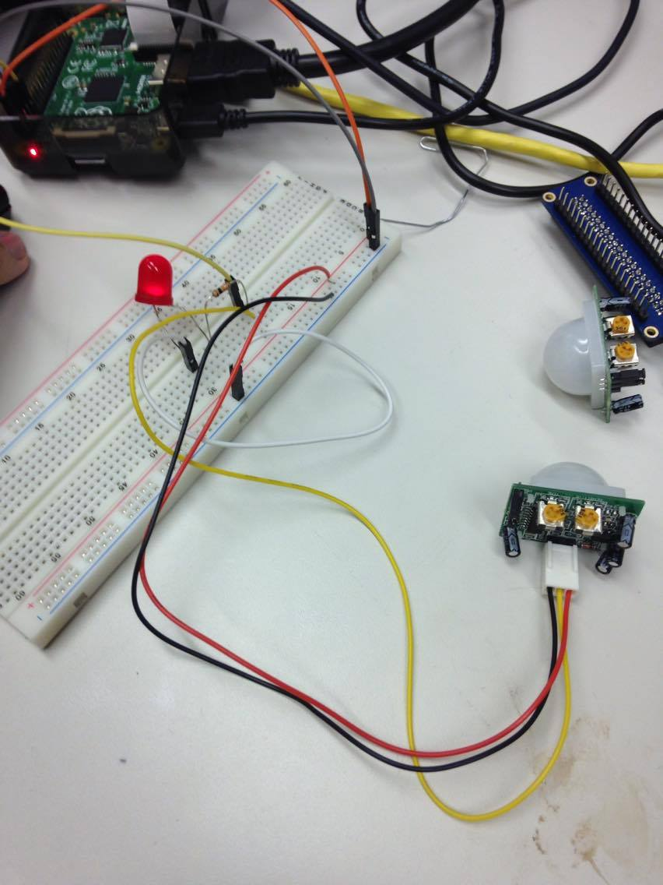
Connecting Sensor AND CAMERA to raspberry pi
Sensor that we have used is the Passive Infrared (PIR) motion sensor.

Slide 5
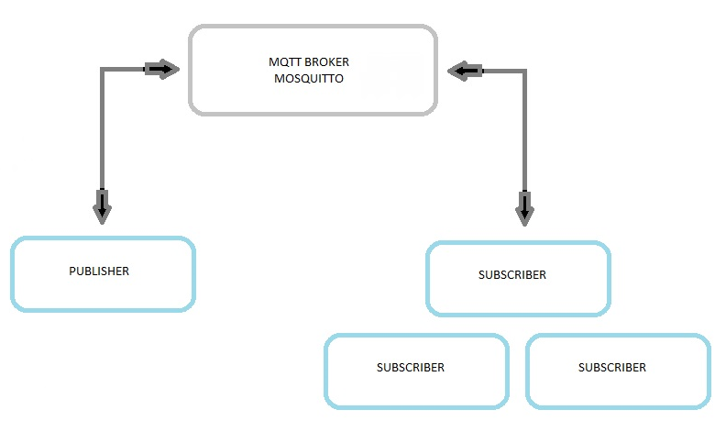
MQTT ARCHITECTURE

Slide 6
Basic Setup And Features
Install MQTT broker
Generate CA certificate
Generate Server side and Client side certificates and keys
Install Paho MQTT lirary
Connect all the sensors to the raspberry pi
Take a photo upon motion detection
Send the picture to a different repository using the MQTT system
Send an alert to user via email

Slide 7
SMART CAMERA FEATURES
IoT Network Encryption
Creation of OpenSSL CA certificates
Creation of Server and Client certificates and keys
Enabling network access upon authentication
Authentication:
Creation of a whitelist determining the username and their corresponding password hash
Send and Receive:
Transmission of the Intruder images over a secured network using Certificates and keys
Send an alert to user regarding Intrusion

Slide 8
IMPLEMENTATION
MQTT BROKER
MQTT PUBLISHER
MQTT SUBSCRIBER

Slide 9
THANK YOU

